Slide 1
Accessing Databases with JDBC
Chapter 24

Slide 2
Introduction
A database is an organized collection of data
A DataBase Management System (DBMS) allows many users to simultaneously: store, organize, retrieve, modify data
Many types of databases exist:
Navigational
Relational
Object -oriented
NoSQL
Document Oriented
Schemaless

Slide 3
Relational Databases
A Relational Database Management System(RDBMS) stores data in tables
Each row in a table describes one entity, or piece of data
A row is made up of columns that store the values
Each row has a subset of columns that compose a primary key
The primary key uniquely identifies a row, so it must be unique
A schema describes the column types that make up each row
Common Relational Databases:
Proprietary: Microsoft SQL Server, Oracle, Sybase, IBM DB2
Open Source: PostgreSQL, MariaDB, MySQL, Derby(JavaDB)

Slide 4
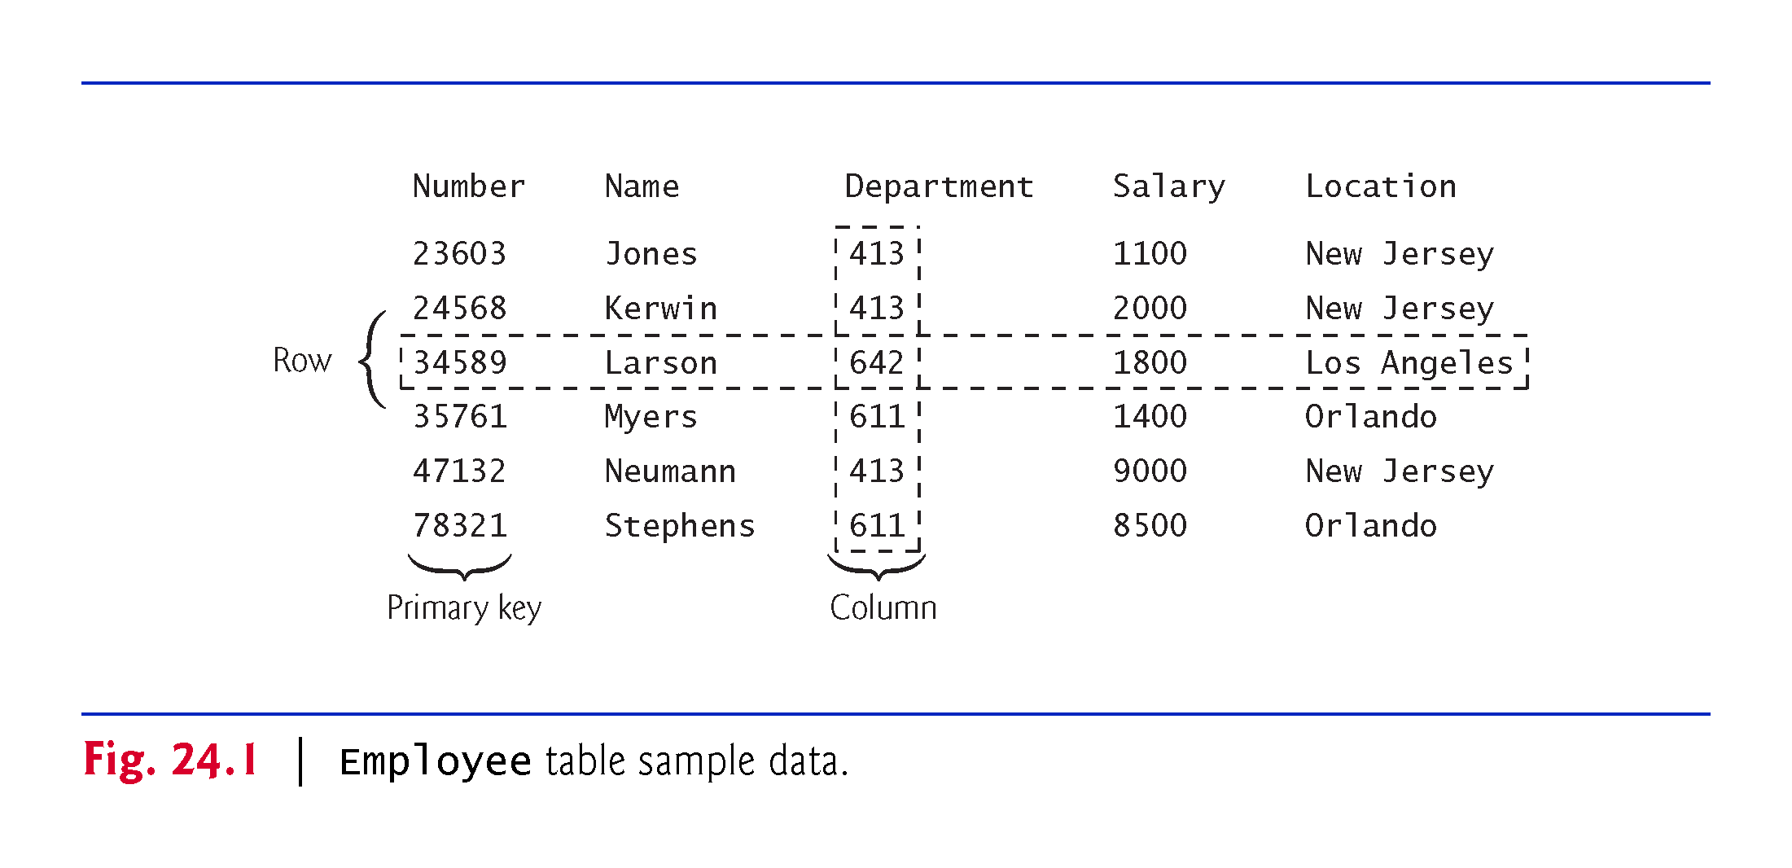
Sample Relational Database Table

Slide 5
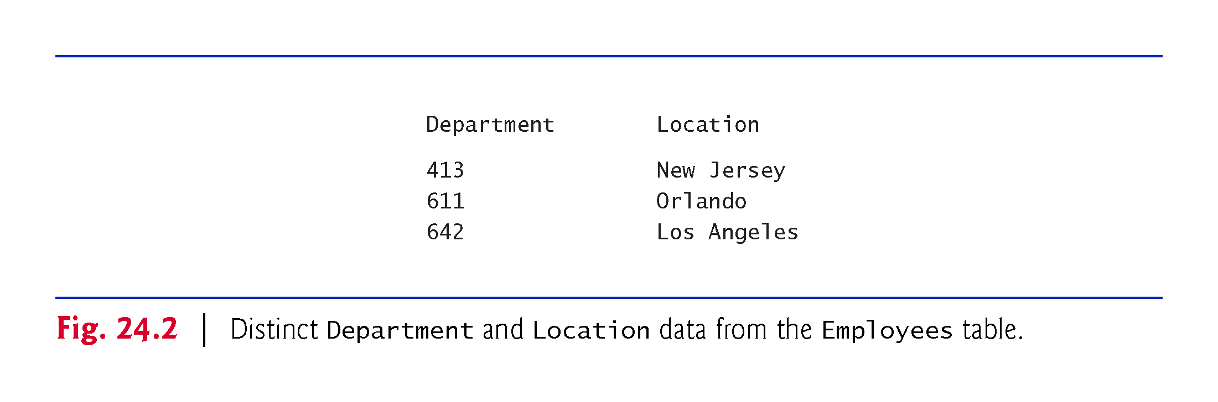
Sample Relational Database Table

Slide 6
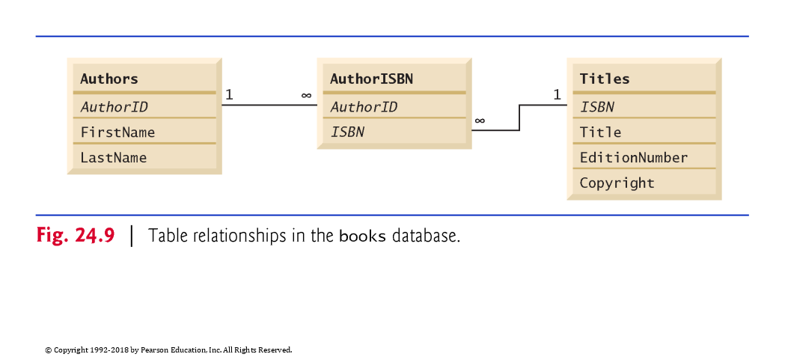
Case Study: A Books Database

Slide 7
Derby/JavaDB
Apache Derby is an open source database written in Java
Can be embedded in a Java application
Useful for testing so that a full database is not required
Packaged as JavaDB and bundled with the JDK
No longer packaged with JDK in Java 9+

Slide 8
Code Review
Creating a database and a table

Slide 9
SQL - Structured Query Language
Structured Query Language - used to insert or retrieve data from a database
SQL typically pronounced “sequel”
SQL is case insensitive, but it is common to use ALL CAPS for keywords

Slide 10
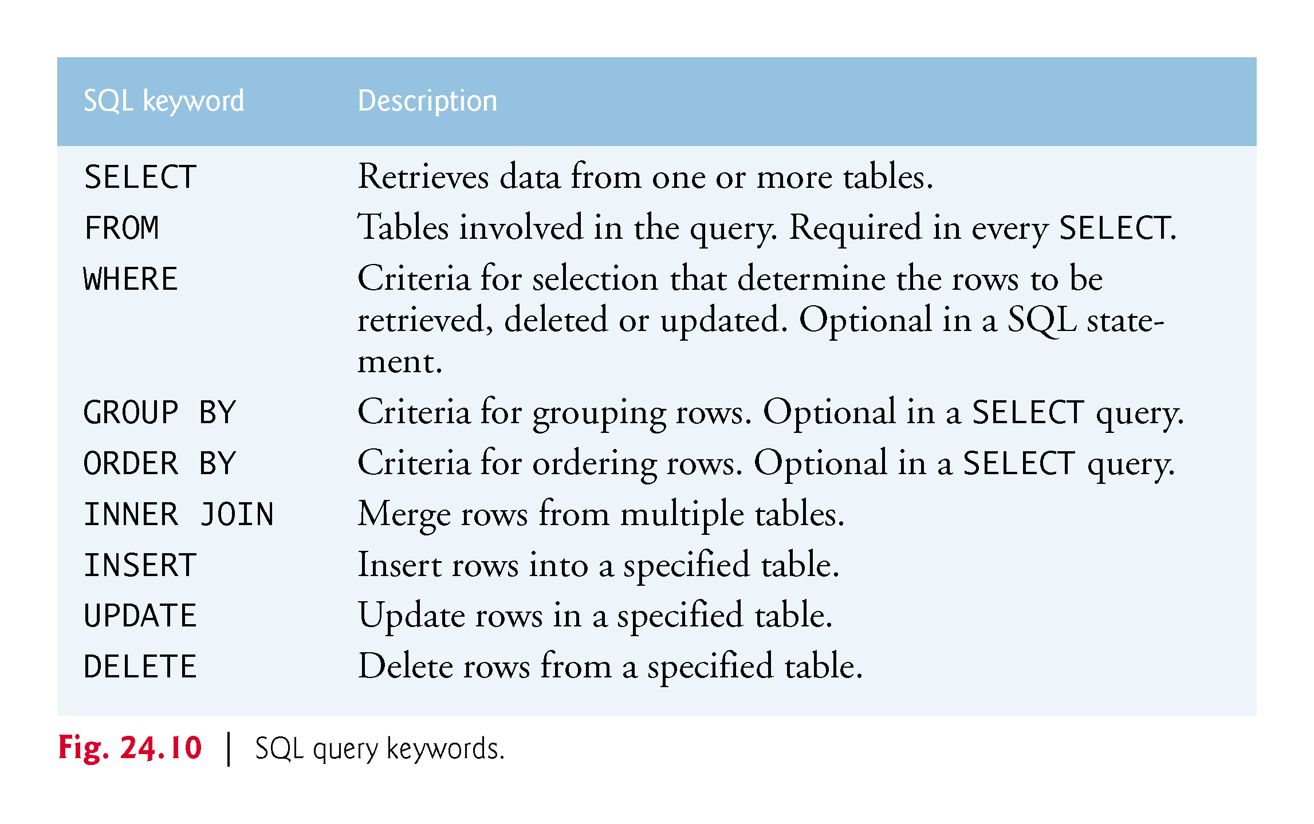
SQL Keyword Reference

Slide 11
The SELECT Statement
A SELECT statement retrieves data from a database
Syntax: SELECT column1, column2, ... FROM tableName
columnn: a comma separated list of column names to retrieve
* means all columns
tableName: the name of the table to query

Slide 12
The WHERE Clause
A WHERE clause allows a SELECT query to narrow its results
Syntax: SELECT columnName1, columnName2, ... FROM tableName WHERE criteria
Valid operators in criteria predicate: <, >, <=, >=, =, <>(not equal), and LIKE
LIKE is used for pattern matching
OR/AND can be used to build complex predicates

Slide 13
The ORDER BY Clause
The ORDER BY clause allows a SELECT query to order its results
Syntax:
SELECT columnName1, columnName2, ... FROM tableName ORDER BY columnNameA, columnNameB, ... ASC
SELECT columnName1, columnName2, ... FROM tableName ORDER BY columnNameA, columnNameB, ...ASC

Slide 14
The INNER JOIN clause
An INNER JOIN allows data from multiple tables to be combined
Syntax:
SELECT columnName1, columnName2, ... FROM table1 INNER JOIN table2 ON table1.columnNameA = table2.columnNameB
The qualified name syntax(table.column) is needed when both tables have the same column name; otherwise it is optional

Slide 15
The INSERT Statement
INSERT inserts a new row into a table
Syntax:
INSERT INTO tableName (col1, col2, ..., colN) VALUES (val1, val2, ..., val3)

Slide 16
The UPDATE Statement
An UPDATE modifies data in the table
Syntax:
UPDATE tableName SET col1=val1, col2=val2, ..., coln = valn WHERE criteria

Slide 17
The DELETE Statement
DELETE removes rows from a table
Syntax:
DELETE FROM tableName WHERE criteria

Slide 18
References
Deitel, Paul J., Deitel & Associates, Inc., and Harvey Deitel. Java How to Program, Early Objects. 11th ed. Pearson, 2018.
"Java Documentation." Oracle Java Help Center. Accessed July 06, 2017. https://docs.oracle.com/en/java/.

